Slide 1
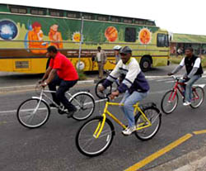
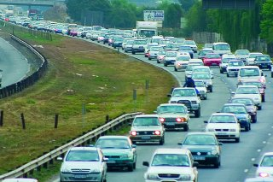
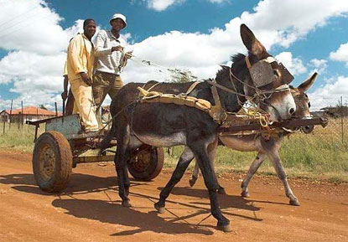


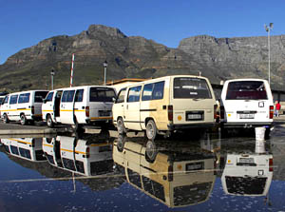

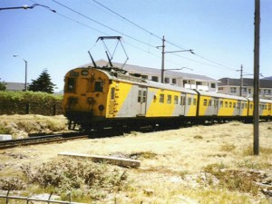
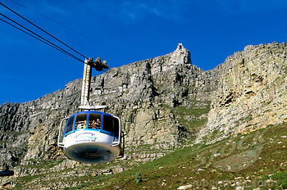
Modelling Energy Demand in South Africa Energy Systems Research Group – University of Cape Town

Slide 2
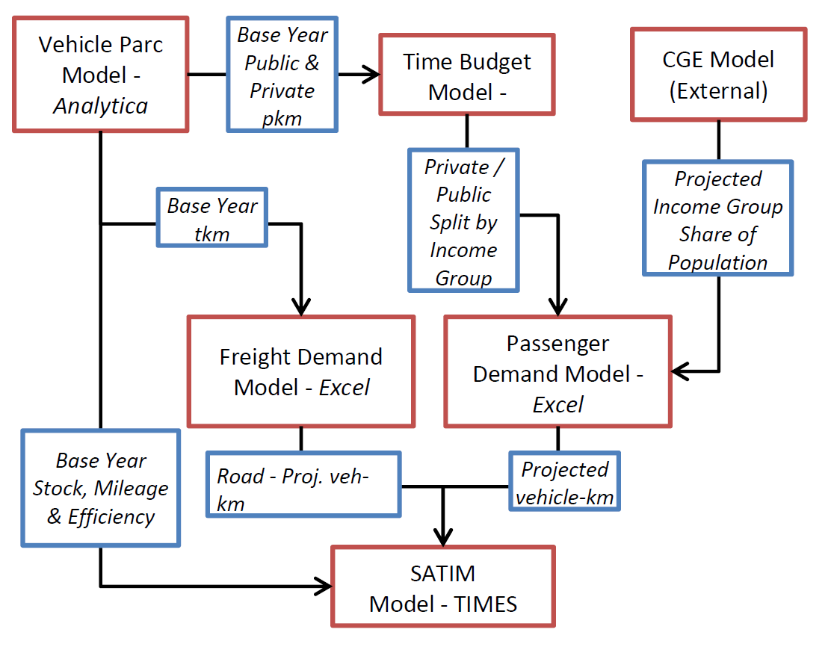
Overview of Transport in SATIMGE
Projected demand for freight services

Slide 3
SATIM Full Sector Energy Systems Model (rough sketch)
Heating Demand
Natural Gas
Liquid Fuels
Veh-km Demand
Crude Oil
Electricity
Coal
Liquid
Electricity
Primary Supply
Coal
Transformation
Transmission and Distribution
Gas
Demand
Coal Transport
Coal Power Plants
Coal Boiler
Coal Mines
Gas Power Plants
Liquid Fuels
Distribution
Gas Boiler
Crude Imports
RE Power Plants
Liquid fuels Imports
Crude Refineries
ICE Vehicle
Gas Imports
Gas Network
Pipeline
Coal to Liquids Plant
Electricity Network
Electric Vehicle
Gas Imports
LNG Terminal
Notes:
This slide shows what we call a Reference Energy Diagram of the energy system. It has more detail than the energy balance in that we also describe which energy services are met by the energy commodities.
1. The demand for energy services are more strongly linked to the economic drivers: GDP, population and income.
2. Different carriers can be used to meet the same energy service demand.
With a detailed description of how energy is produced and consumed, we use an optimization approach to compute the least-cost technology mix (both on supply and demand) given scenario based, “out of sample” projections of:
The energy service demand of the economy given
retirement of the existing stock of energy equipment (coal power plants),
new technology costs, and
Fuel prices
Policy levers (e.g. GHG reduction goal)

Slide 4
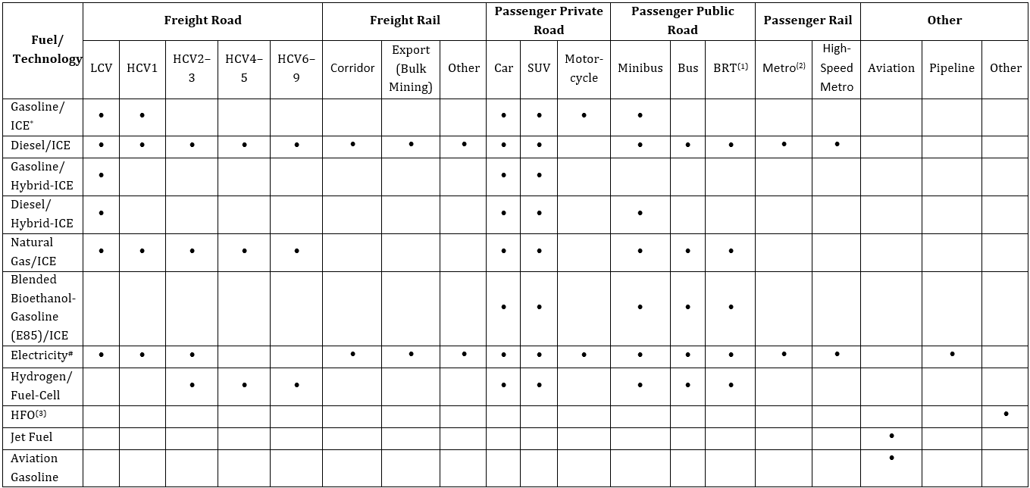
SATIM Transport Vechicles
(1): BRT: Bus Rapid Transport; (2): Metro: Metropolitan i.e. intra‐city; (3): Used for Coastal & Inland Navigation; * Internal Combustion Engine; #: Battery Electric for Road Vehicles; HCV1: Medium commercial vehicle of 3 000–7 500kg GVM; HCV 2: Heavy commercial vehicle of 7 501–12 000 kg GVM; HCV 6: Heavy commercial vehicle of 24 001–32 000 kg GVM. SUV: Sport Utility Vehicle (usually 4X4 and >1ton in mass)
Notes:
This slide shows the detail of the vehicle park that makes up the transport sector demand

Slide 5
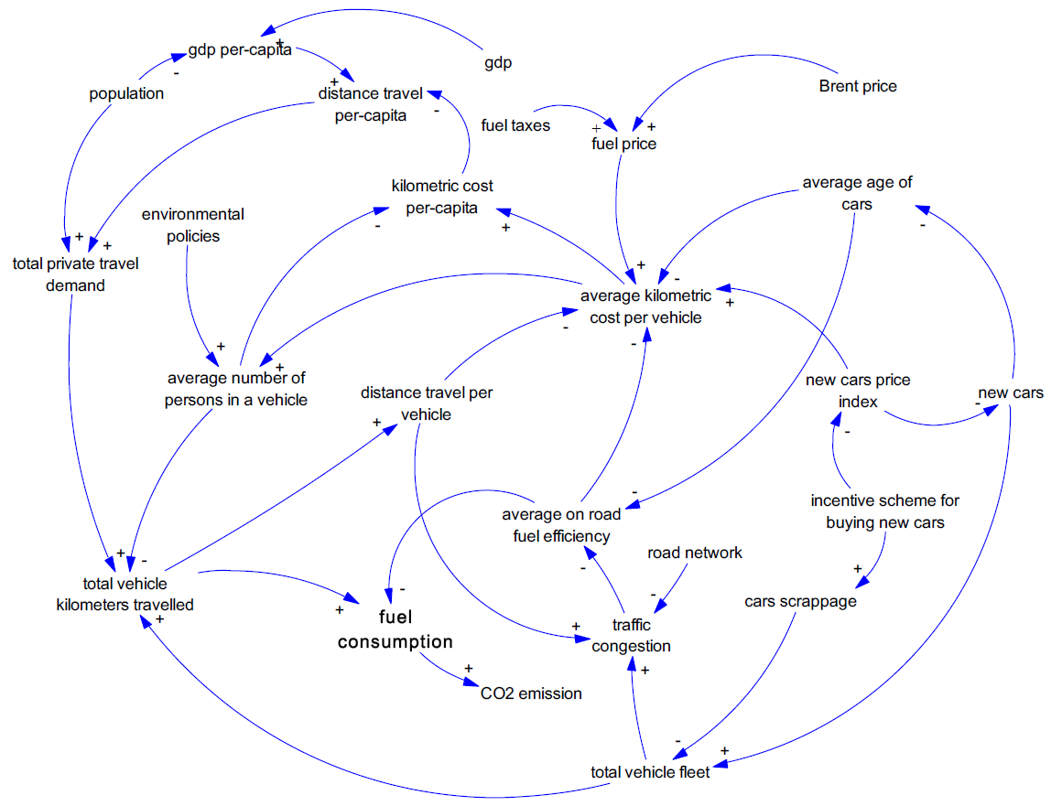
Passenger Transport is quite complicated
Source: S. Armenia et al.

Slide 6
Common Approaches
Start
Check
Km per person per year
Total Pkm
Pkm by Mode
Vkm by Mode
Vehicle parc
1.
Population
Mode Share
Occupancy
Mileage
To TIMES Model
Start
Check
Vehicle Parc (all modes)
Total Vkm
Pkm by Mode
Total Pkm
Km per person per year
2.
Mileage
Occupancy
Sum across modes
Population

Slide 7
Approach 1: Problem
Start
Check
Km per person per year
Total Pkm
Pkm by Mode
Vkm by Mode
Vehicle parc
1.
Population
Mode Share
Occupancy
Mileage
Assumes that km per person per year is independent of mode share

Slide 8
Approach 2: Problem
Start
Check
Vehicle Parc (all modes)
Total Vkm
Pkm by Mode
Total Pkm
Km per person per year
2.
Mileage
Occupancy
Sum across modes
Population
Different modes are projected independently

Slide 9
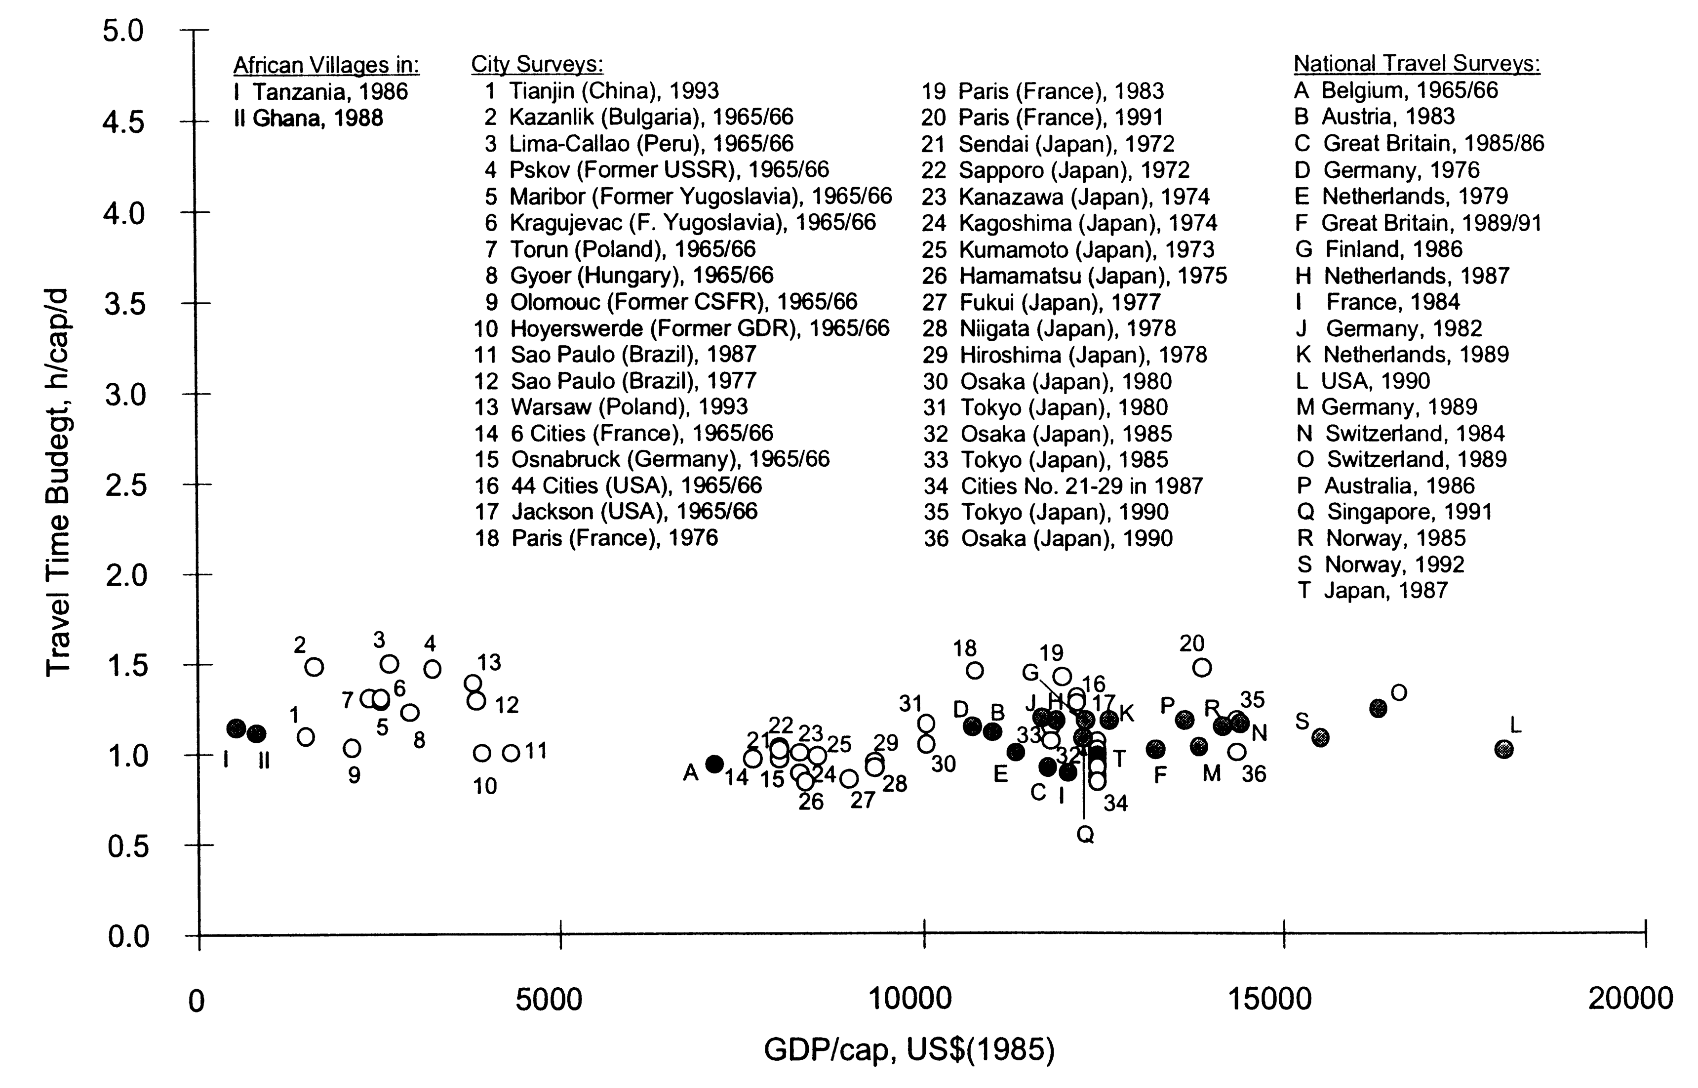
Approach adopted: 2 with fixed travel time budget
Inspired by Schafer & Victor (2000)
Use travel time budget in combination with mode speeds to ensure inter-modal consistency

Slide 10
Adopted Approach
Start
Mileage + Occupancy
Priv.Speed
Time budget
Pub.Speed
Vehicle ownership (private)
pkm in private
Time spent in private travel
Time spent in public travel
pkm in public
Check
Mode Share

Slide 11
Saturation comes from income group population
Motorisation is highly correlated to GDP/Capita. Often modelled by a Gompertz Curve (see Kenworthy & Townsend,)
Saturation Occurs when Net Transition to Income Group High stabilises at a low rate
Fraction No Car
Fraction Pass. Car Owners
Income Group Low
Income Group Medium
Income Group High

Slide 12
Income Group Behaviour

Slide 13
Illustrative BRT (Bus Rapid Transit) Case
People with access to a private vehicle
People without access to a private vehicle

Slide 14
Overall Mode Share (pkm)

Slide 15
SANEDI Study Results: Projecting Energy Demand Step 1

Slide 16
Results: Projecting Energy Demand Step 2
SANEDI report can be downloaded from ERC Website
And so can the TIMES model and the accompanying spreadsheets

Slide 17
Still a Lot of work left to do:
1. Household budget constraint
Schafer & Victor (2000)
2007 SAM

Slide 18
Still a Lot of Work to do:
2. Endogenising modal choice based on relative cost or utility: From System’s point of view of Traveler’s point of view?
Household
Income proj.
Priv. Vehicle
ownership
Occupancy
proj.
Annual Mileage
proj.
Transport
/Energy Policy
Taxes and
Subsidies
Relative cost
of modes
Mode Share
/pkm proj.
Relative speed
of modes
Relative cost
of techs proj.
Vehicle km
by mode
Fuel price
proj.

Slide 19
Questions?

Slide 20
Challenge: Data is Sparse
We have
We want
NAAMSA
Vehicle Sales
Fuel
Consumption
Enatis
veh. pop
Vehicle km
Natmap/SOL
P-km, t-km
Detailed
Vehicle Parc
SAPIA/EB
Fuel sales
P-km, T-km/
Mode-share

Slide 21
Calibration Process
Scrapping
Factor
NAAMSA
Vehicle Sales
Vehicle Parc
Model
Enatis Check
Vehicle
Mileage/Decay
Vehicle km
Occupancy
P-km, T-km/
Mode-share
Fuel
Consumption
Fuel Economy/
Improvement
Natmap/SOL
Check
SAPIA/EB
Check

Slide 22
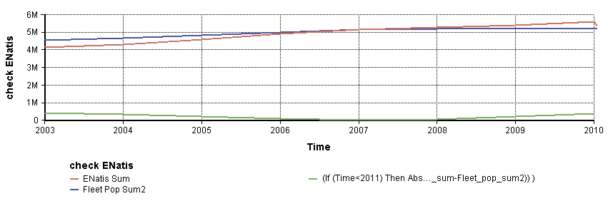
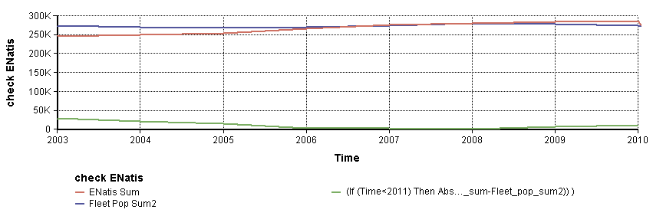
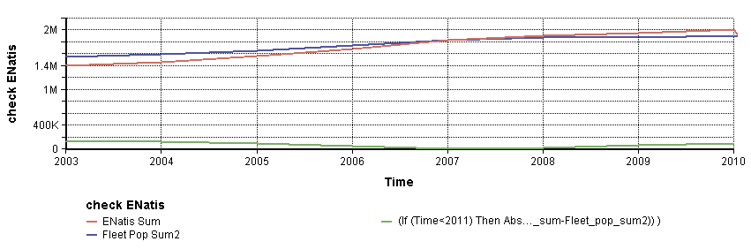
Some Calibration Results: Car Parc
Cars
Minibus
Light Duty Vehicles

Slide 23
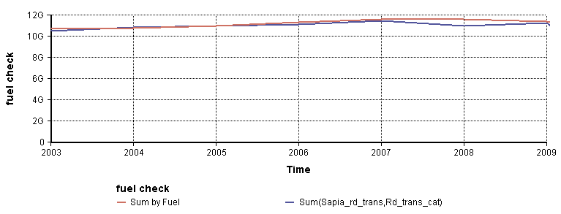
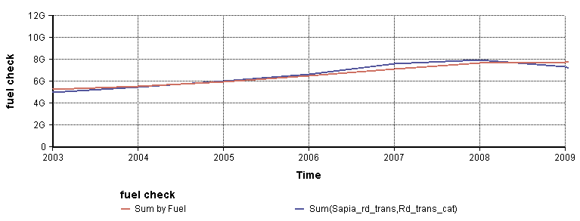
Some Calibration Results: Fuel Sales (litres)
Gasoline
Diesel

Slide 24
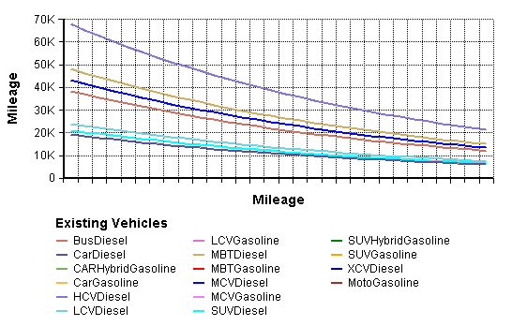
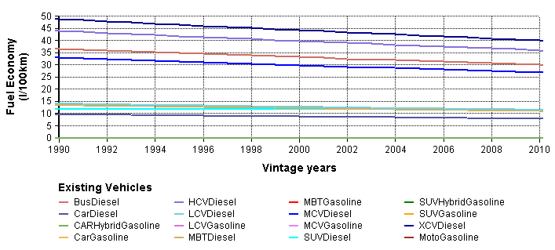
Some Calibration Results: Vehicle Mileage and Fuel Consumption
Years
Diesel Vehicles

